Slide 1
Aran
PITCH DECK
A firewall for personal data in motion. It swaps identifiers for safe tokens before any log, vendor or AI ever sees them.
TEAM ID
TEAM NAME
PROBLEM STATEMENT
To be added
Team Aran, KARE
Prevent Sensitive Data Leakage

Slide 2



The Problem
Who faces it
Every organisation that holds personal data. It leaks through logs, vendor copies and AI chatbots.
₹22 cr
Why it matters
India's DPDP Act allows fines up to ₹250 crore, and its duties begin on 13 May 2027.
Average cost of one data breach in India
How they deal with it today
Pattern filters and masking. One OTP pattern raised 67,481 false alarms on 32,000 real log lines.
Source: IBM Cost of a Data Breach, 2025

Slide 3
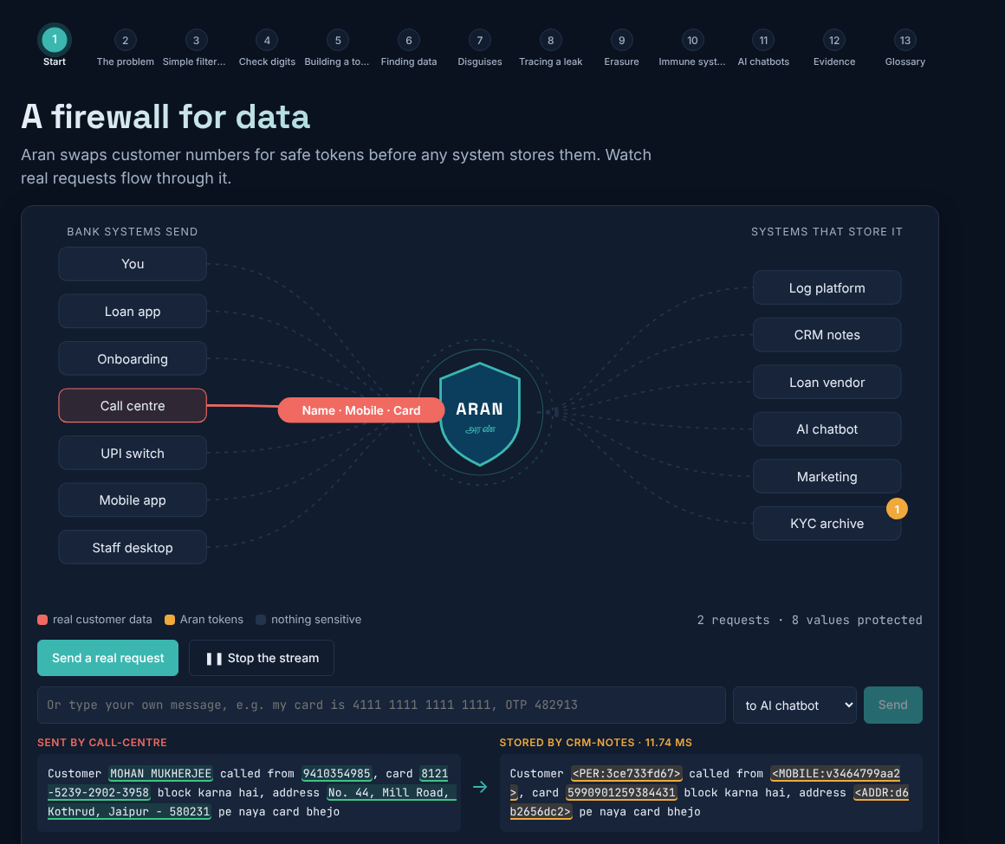

Our Solution
Aran sits on every path data leaves by and swaps identifiers for look-alike tokens.
Tokens always fail the check digit, so anyone can tell protected from leaked
Each destination gets its own tokens, so a leaked file names its source
One key per person and purpose: erasing data is one key deletion, with a receipt

Slide 4

How It Works
1
2
3
Connect
Detect and swap
Only tokens leave
Point logs, APIs, exports or AI prompts at Aran with one URL or the SDK
Check-digit maths, AI models and registries find identifiers and swap them
Vendors, logs and AI see tokens. Leaks are traced and erasure is proven

Slide 5
What Makes Us Different
Pattern filters and masking
Aran
False alarms bury the real leaks
Tokens look exactly like real numbers
Masks still leave few enough guesses
Deleting rows misses backups and vendors
Maths and calibrated AI: alarms 2,506 to 60
Tokens provably fail the checksum
A ledger budgets what systems learn together
Shred one key, get a quantum-safe receipt
VS

Slide 6


Proven on Real Data
91%
0
100%
Values removed
Tokens taken as real
Leaks traced
On 16,000 unseen real log lines; plain regex removes 46%
Out of 20,000 tokens mixed into real logs
Leaked files matched to the right one of 40 vendors

Slide 7
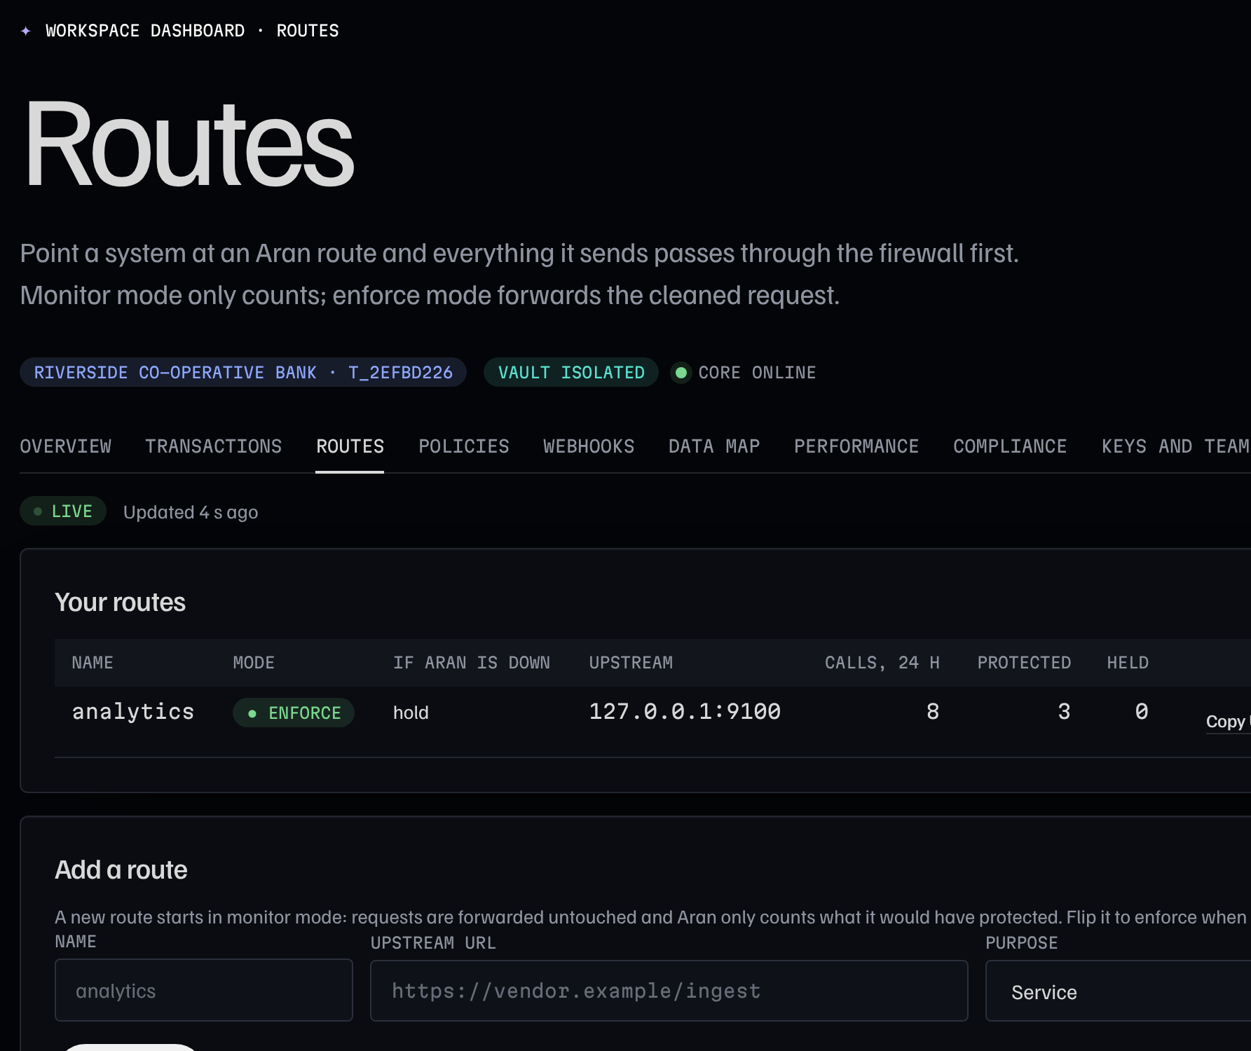
Firewall as a Service
Aran Cloud: any company signs up, gets a workspace and puts Aran in the path.
Routes: point a system at Aran and it forwards the cleaned request
Policies start in monitor mode, then switch to enforce
Signed alerts to the security team, and a data plane that runs on site

Slide 8
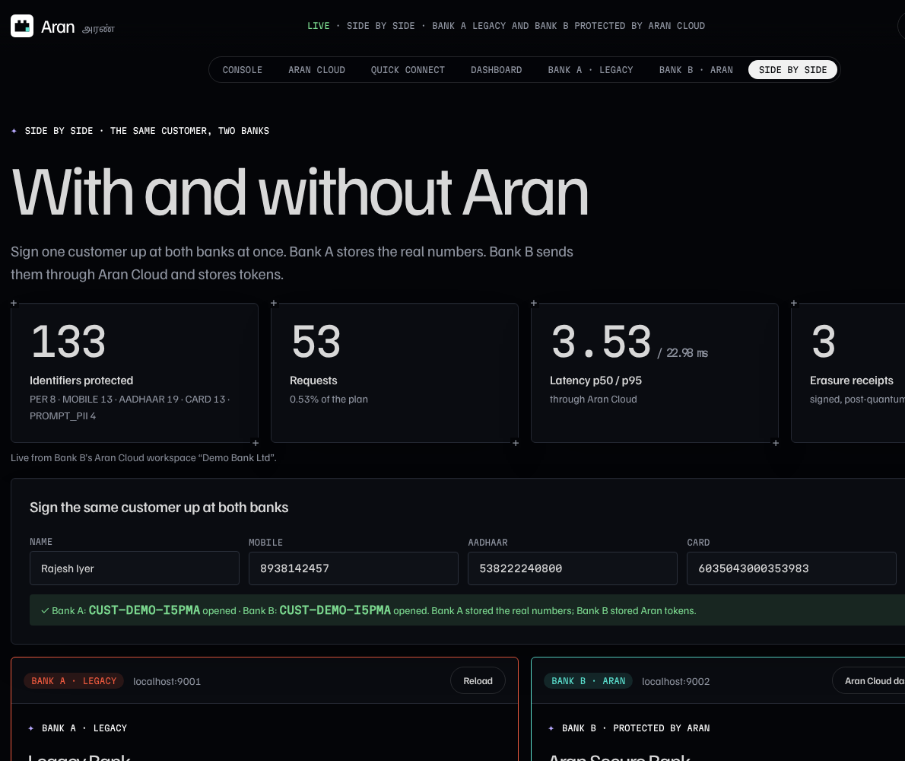
Live Demo
Same customer, two sample firms: one keeps raw numbers, one uses Aran.
Running now at aran-console.onrender.com
Beat the firewall: judges try to slip data past it from their phones
Guided tour in English, Tamil and Hindi

Slide 9
Market & Impact
6+
₹250 cr
0%
Sectors
At stake
Numbers sent to AI
Finance, health, telecom, retail, government and SaaS
Top DPDP fine that every Indian data holder faces from 2027
Identifier numbers reaching an AI provider in our test, down from 100%

Slide 10
What We Build Next
1
2
3
Built
Next
Pilot
Firewall core, AI layers, Aran Cloud, routes, policies and webhooks
Faster engine for 10,000 lines a second, Postgres and more identifier types
On-site data plane with a partner's consented logs, then re-measure

Slide 11

Our Team
Inbathamizhan S
Aasif Ahmed A
SN Arun Vijay
Bharadhwaj M
Team lead
Cybersecurity
AI/ML
AI/ML
Architecture, crypto
Keys, tenants, red team
Detection, Aran Cloud
Name finder, OCR

Slide 12
Thank You
Team Aran | KARE
aran-console.onrender.com · github.com/itzz-inbathamizhans/aran

